Slide 1
Hi presenter! Read me before using!
This webinar resource is almost ready for you to use! Be sure to:
Look through and add custom information
Slide #2- Title slide (date)
Slide 3- Presenter information
Slide 5- Housekeeping items
Slide 7- Personalizing your Online Classroom (optional)
Slide 26- Resources (optional)
Slide 28- Thank you slide
There are presenter notes to help guide you- feel free to edit these
This resource can be customized. Here are some examples of how you can personalize this slide deck to suit the needs of your educators and staff:
Replace our images with screen shots from your environment
Read through slides and ensure terms and jargon will resonate with your board policies/ tool names in your Brightspace environment (i.e. Assignments vs Dropbox, Announcements vs News etc)
Add additional information to slides specific to your district, including how this helps meet district goals, improvements plans, strategic plans etc
Include your district logo on slides or change the colors used to match your district branding
Notes:
For this webinar in particular, it is important to edit the slide show and screen shots to match the terminology your District uses (i.e. Announcements vs News)

Slide 2
Personalizing your Online Classroom
<insert date>
© 2020 D2L Corporation
Notes:
In face to face teaching, we think carefully about how to design our physical classroom space to meet the needs of our learners. Online, it is important to ensure that your virtual classroom is still personalized for you and your class. In this webinar, you will learn how to customize and personalize your online classroom to meet the needs of you and your students.

Slide 3
Presenter Name Title Company/Organization
@Twitter handle

Slide 4
Agenda
How to choose and share digital tools for your students to use
How to design the look and feel of your online classroom
Resources
Notes:
Today, we’ll be discussing the various video tool options in Brightspace. Our agenda for today is:
What video options are available in Brightspace?
How can I use the video tools in Brightspace?
Resources

Slide 5
Housekeeping Items
How can people ask questions?
Webinar recording and slide deck will be available on ___________
Information about attendance
Notes:
This slide is for you to add Housekeeping Items particular to your District and this session.
It may include information about how attendees can ask questions, how they can access the webinar information after the session, or even how they confirm their attendance for the session (if applicable)

Slide 6
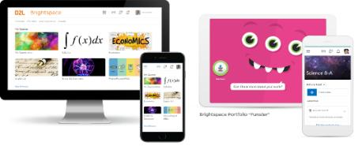
Understanding some terms...
Company:
D2L
Product:
Brightspace
Online Community:
Brightspace Community
Notes:
This is a useful slide to ensure everyone understand the terminology used when discussing Brightspace.
It would be helpful to personalize this slide to include any District specific information, especially if your District as a different branding for “Brightspace.” This will help attendees when they see resources about “Brightspace” to know that this is what your District is using as well but has branded differently.

Slide 7
Personalizing your Online Classroom
Look and feel
Resources
Organization
Personality and class interests
How can my students confidently and easily access tools and information?
Notes:
When we think about personalizing our classroom space, we often think about displays, bulletin boards, etc which is certainly important in creating an engaging and productive space. This is important and we’ll discuss how you can personalize your course look and feel, but what is also important in personalizing our classroom space is which resources are made available and where do they live? For example, how do I have my room and desks organized for the best flow and building a classroom community? Where are my resources? Are they easily accessible? What resources are available? A lot of this comes naturally to us in the physical classroom and, after a while, we learn what works for us and our students, but those are the same questions we need to ask ourselves about our online space: what resources do my students need? How am I making them available? And what is the best way to organize my space to customize and personalize for my students’ needs?

Slide 8
Personalizing your Online Classroom in Brightspace:
Navbar
Homepage
Widgets
Course Banner
The Navbar is an easy way for you and your students to easily access a wide variety of tools
The landing page for your District and also in courses. Similar to a bulletin board where you can display useful information and resources for your students
Great way to customize what information is displayed on your homepage or to create a “ digital bulletin board”
A space to personalize your course image or display a message or information to students
Notes:
Use this slide to introduce some of the tools or features you will discuss and cover during the demo
**Be sure to confirm the terminology on this slide matches the language terms used in your District’s Brightspace environment

Slide 9
Personalizing your Online Classroom Demo
Learning Objectives:
You will be able to:
Customize your Navigation Bar (Navbar)
Customize your Homepage
Create a custom Widget
Edit your Course Banner
Notes:
Next we’ll head into a live demo to show you how you can personalize your online classroom
Note: The learning objectives on this slide can be personalized to meet the needs for your District and attendees

Slide 10
Edit your Navbar (1/2)
1
2
Place your cursor in the top right corner of your Navbar. An options menu will appear (the ellipsis). Click the menu.
Select “Edit This Navbar”
Notes:
This slide can serve as a resource for your educators & staff after the webinar. It can also serve to help with step by steps instructions if doing a live demo is not possible.
Another option is to let your attendees know these how-to slides are in the slide deck for them to reference, and hide the remaining slides during the live webinar, and unhide them prior to send the slide deck to your attendees after the webinar.

Slide 11
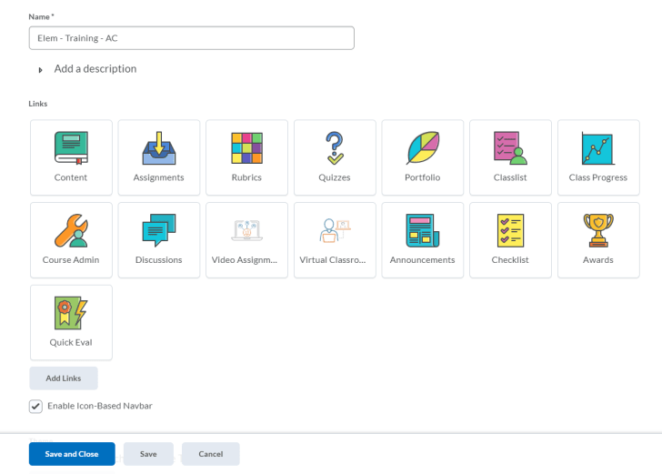
Edit your Navbar (2/2)
1
Change title of your Navbar, if applicable
Drag and drop link tiles to reorder your Navbar or remove tool links to personalize your Navbar for your class
Add additional tool links or create a custom link (next slide)
Enable the Icon-Based Navbar or disable for a Text-Based Navbar
Save your changes and close the Navbar editing screen
2
3
4
5
Notes:
This slide can serve as a resource for your educators & staff after the webinar. It can also serve to help with step by steps instructions if doing a live demo is not possible.
Another option is to let your attendees know these how-to slides are in the slide deck for them to reference, and hide the remaining slides during the live webinar, and unhide them prior to send the slide deck to your attendees after the webinar.

Slide 12
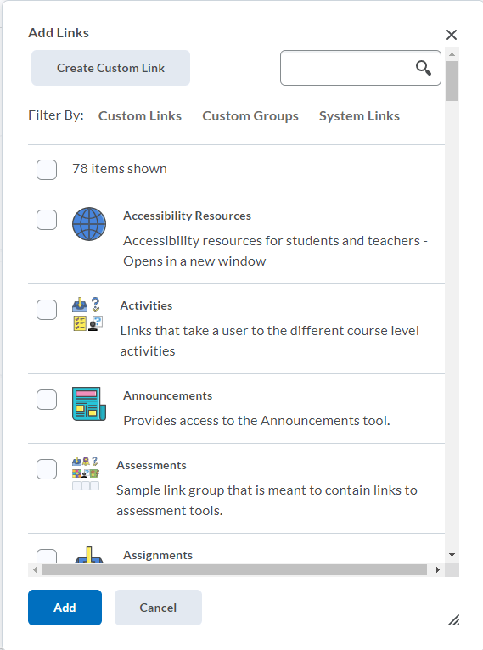
Adding a New Link
3
1
Search, browse or filter for the tool links you’re looking to add
Custom Links= Created by you or your District
Custom Groups= a cluster of tool links created by your District
System Links= tool links created by D2L and available in Brightspace by default
Once you’ve found a link you want to add, click the box beside it to select it
OR create your own custom link for your Navbar (see next slide)
Add the link(s) you selected to your Navbar
2
4
Notes:
This slide can serve as a resource for your educators & staff after the webinar. It can also serve to help with step by steps instructions if doing a live demo is not possible.
Another option is to let your attendees know these how-to slides are in the slide deck for them to reference, and hide the remaining slides during the live webinar, and unhide them prior to send the slide deck to your attendees after the webinar.

Slide 13
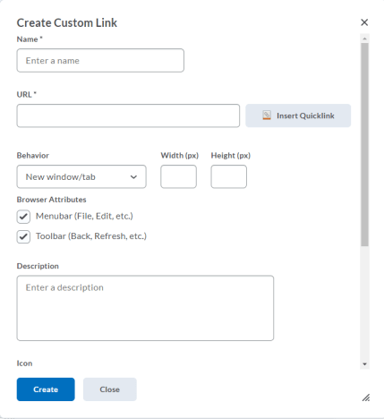
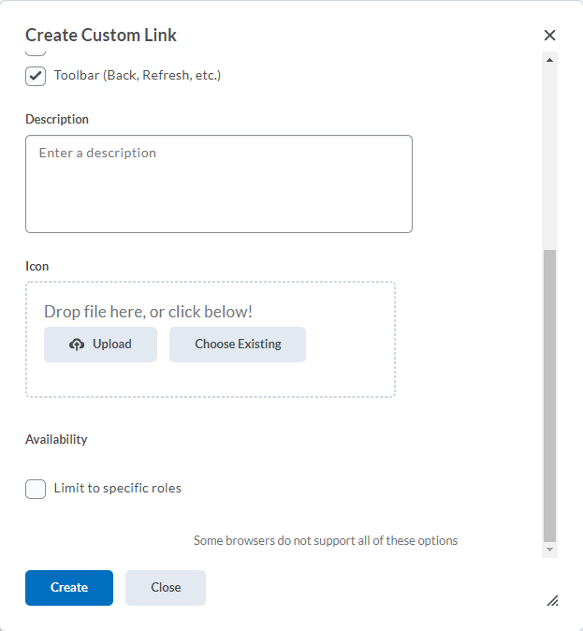
Create a Custom Link for your Navbar
Title your Custom Link
Attach the URL or Quicklink to another area of your Brightspace Course. This is where students will land once they’ve clicked the link in the Navbar
Decide what behavior the link will have: will it open in the same tab, a new tab etc
Provide a description for your link so you remember what the link does for future use
Upload an icon for your link
Leave this unchecked if you want everyone in your course to see this icon. However, you can choose to limit which roles can and cannot see it. If this link is only for you as the educator, I would limit it so that only the “teacher” role (or whatever role you are in your District) could see the icon.
Create your link!
1
2
5
3
4
6
7
Notes:
This slide can serve as a resource for your educators & staff after the webinar. It can also serve to help with step by steps instructions if doing a live demo is not possible.
Another option is to let your attendees know these how-to slides are in the slide deck for them to reference, and hide the remaining slides during the live webinar, and unhide them prior to send the slide deck to your attendees after the webinar.

Slide 14
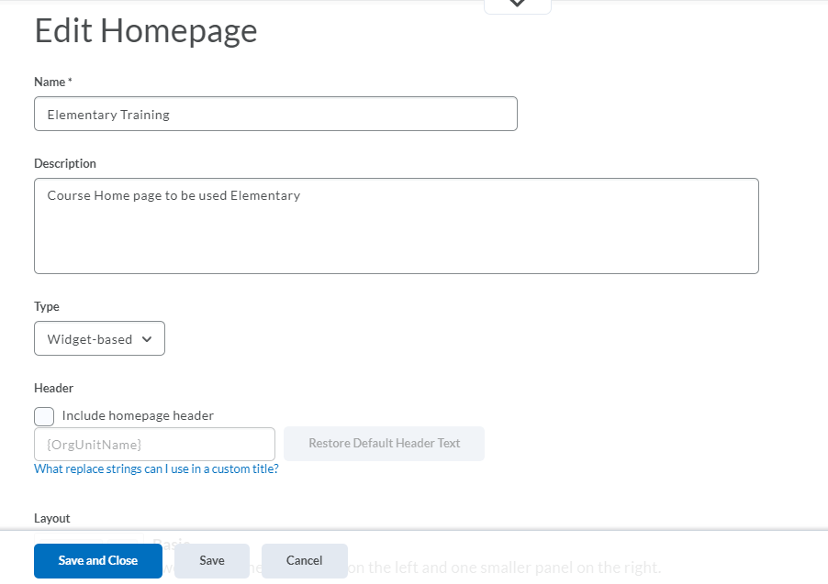
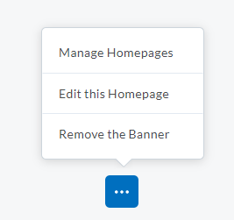
Edit Your Course Homepage (1/3)
3
2
4
1
5
Scroll to the bottom of your Homepage and look for the Homepage Actions Menu (the ellipsis).
Click to open the menu and select “Edit this Homepage.” If you don’t see this option, head to slide 17: Making your Course Homepage Editable
Give your new Homepage a name and description. This might include your surname, teaching grade or subject and the current year.
Decide what type of Homepage you will have. Widget-based is the most common and allows for lots of functionality and options on your Homepage. If you only commonly use one tool in your course, you could have a Tool Homepage, which means only the tool you select would show on the Homepage.
If you would like an additional Homepage Header, select this option and decide what information will display there. By default, it will be your Course Code/Name.
Notes:
This slide can serve as a resource for your educators & staff after the webinar. It can also serve to help with step by steps instructions if doing a live demo is not possible.
Another option is to let your attendees know these how-to slides are in the slide deck for them to reference, and hide the remaining slides during the live webinar, and unhide them prior to send the slide deck to your attendees after the webinar.

Slide 15
Edit Your Course Homepage (2/3)
1
2
3
Once you’re in the Homepage edit screen, give your new Homepage a name and description. This might include your surname, teaching grade or subject and the current year.
Decide what type of Homepage you will have. Widget-based is the most common and allows for lots of functionality and options on your Homepage. If you only use one tool in your course, you could have a Tool Homepage, which means only the tool you select would show on the Homepage.
If you would like an additional Homepage Header, select this option and decide what information will display there. By default, it will be your Course Code/Name.
Notes:
This slide can serve as a resource for your educators & staff after the webinar. It can also serve to help with step by steps instructions if doing a live demo is not possible.
Another option is to let your attendees know these how-to slides are in the slide deck for them to reference, and hide the remaining slides during the live webinar, and unhide them prior to send the slide deck to your attendees after the webinar.

Slide 16
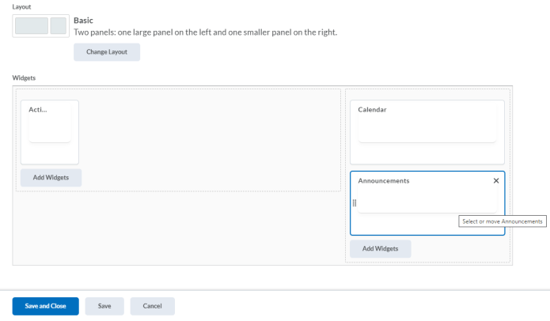
Edit Your Course Homepage (3/3)
4
5
6
For a Widget-based Homepage, this is where you can decide the spacing and layout of your Homepage. If you’re using the Activity Feed widget, I suggest using this “Basic” layout shown above. If you were choosing to have a Tool Homepage, this is where you would choose which tool displays on your Homepage.
Drag and drop to reorganize widgets. Click the “x” to remove to widget. Click “Add Widgets” to select from D2L’s “System Widgets” or your District’s “Custom Widgets” (if they have created their own widgets)
Save your changes and close out of the edit Homepage screen
Notes:
This slide can serve as a resource for your educators & staff after the webinar. It can also serve to help with step by steps instructions if doing a live demo is not possible.
Another option is to let your attendees know these how-to slides are in the slide deck for them to reference, and hide the remaining slides during the live webinar, and unhide them prior to send the slide deck to your attendees after the webinar.

Slide 17
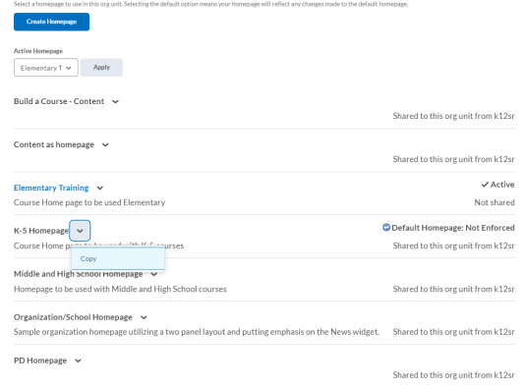
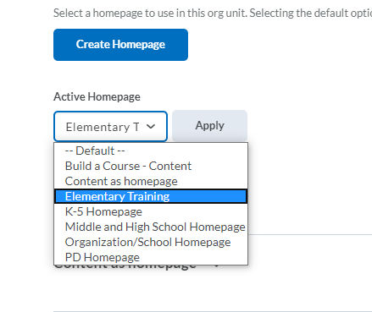
Make your Course Homepage Editable
You can also create a new Homepage from scratch!
This tells me which Homepage my course is currently using
Currently, not editable. I would need to make a copy of it.
5
Blue, clickable font means I have permission to edit this Homepage
3
2
1
Scroll to the bottom of your Homepage and look for the Homepage Actions Menu (the ellipsis) go to Course Admin and click to open the menu and select “Manage Homepages.” Or go to Course Admin and click “Homepages.”
Here you will see a list of Homepages available from your District. If the Homepage title is black, it means you cannot edit (this means the Homepage might be used for several courses!) You will need to click the down arrow beside the Homepage you want to use/edit and click “Copy.” Best practice is to rename this Homepage so that it is identified as your Homepage. Once the Homepage title displays in a blue, clickable font, you can now edit the Homepage. You can click on the blue Homepage title to begin editing it.
Remember select your new Homepage from the “Active Homepage” dropdown menu and click “Apply.” Now this Homepage will be applied to your Course Homepage.
Notes:
This slide can serve as a resource for your educators & staff after the webinar. It can also serve to help with step by steps instructions if doing a live demo is not possible.
Another option is to let your attendees know these how-to slides are in the slide deck for them to reference, and hide the remaining slides during the live webinar, and unhide them prior to send the slide deck to your attendees after the webinar.

Slide 18
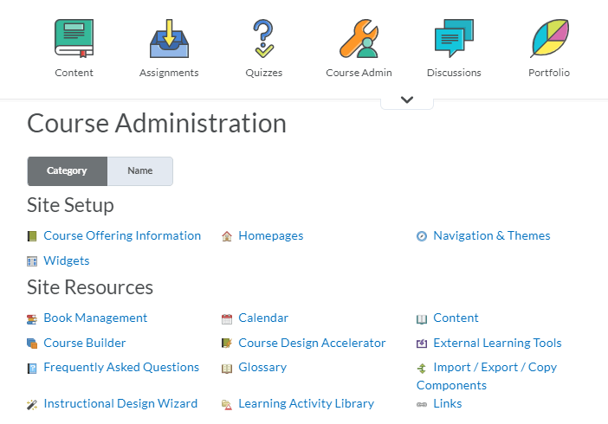
Create a Custom Widget (1/3)
3
1
2
Go to Course Admin
Click Widgets
You can also access widgets from the Homepages area. Click onto the “Widgets” tab and then “Create Widget”
Notes:
This slide can serve as a resource for your educators & staff after the webinar. It can also serve to help with step by steps instructions if doing a live demo is not possible.
Another option is to let your attendees know these how-to slides are in the slide deck for them to reference, and hide the remaining slides during the live webinar, and unhide them prior to send the slide deck to your attendees after the webinar.

Slide 19
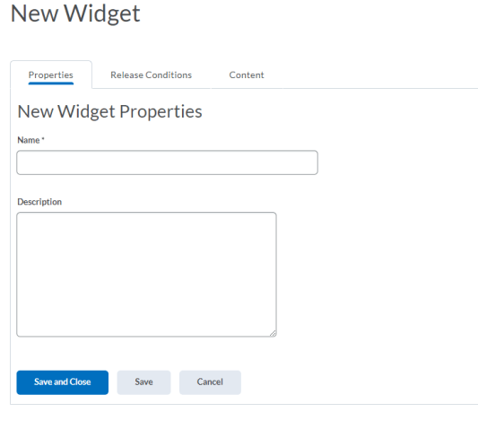
Create a Custom Widget (2/3)
2
Give your Custom Widget a name and a description.
If you want all students to see this widget immediately on the Homepage, skip this step. If you would like to add Release Conditions to your widget, click the Release Conditions tab and add your Release Condition(s). Check out this Release Conditions Quick Reference Guide for more details.
1
Notes:
This slide can serve as a resource for your educators & staff after the webinar. It can also serve to help with step by steps instructions if doing a live demo is not possible.
Another option is to let your attendees know these how-to slides are in the slide deck for them to reference, and hide the remaining slides during the live webinar, and unhide them prior to send the slide deck to your attendees after the webinar.

Slide 20
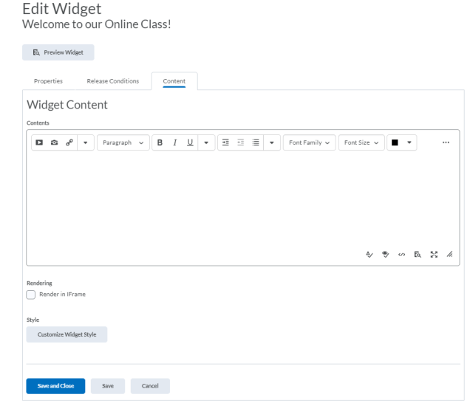
Create a Custom Widget (3/3)
5
Click on the “Content” tab and put some content in your widget! This is what will display in your widget.
If you’d like, you can customize the style of the widget, such as deciding if the title of the widget displays.
If you wish, preview your widget to ensure it looks exactly as you’d like it to!
Save your custom widget and close! You can now add your widget to your Homepage!
3
4
6
Notes:
This slide can serve as a resource for your educators & staff after the webinar. It can also serve to help with step by steps instructions if doing a live demo is not possible.
Another option is to let your attendees know these how-to slides are in the slide deck for them to reference, and hide the remaining slides during the live webinar, and unhide them prior to send the slide deck to your attendees after the webinar.

Slide 21
Customize your Course Banner
1
2
Click the ellipsis on the top right of the Course Banner to select your options menu
Choose either “Change Image” or “Customize Banner Text”

Slide 22
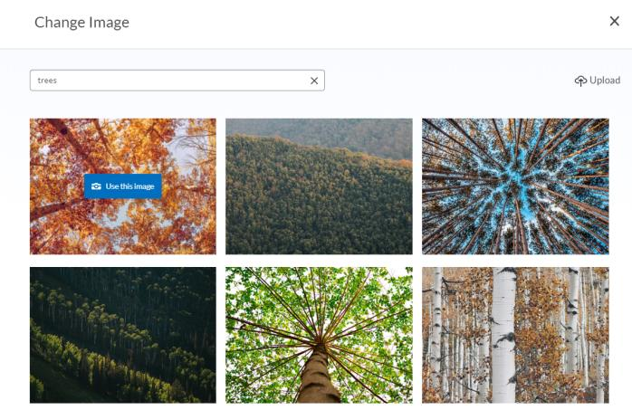
Customize your Course Banner Image
1
2
To use an image from our photo library, type in a search term. When you’ve found an image you want to use, place your cursor on the image and click “Use this image”
Have your own image that you’d like to use? Great! Just click the “Upload” option in the top right corner to upload your own image.

Slide 23
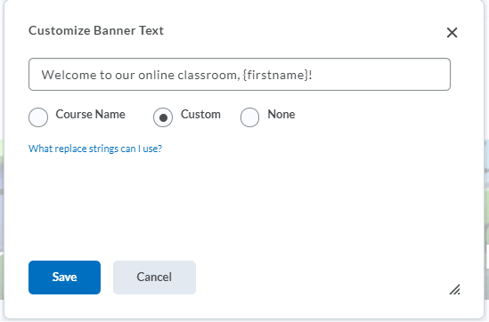
Customize your Course Banner Text
1
Tip! Use the replace string {firstname} to personalize the text to include your student’s name! When your student sees the banner, they’ll see their own name instead of {firstname}!
2
By default, your Course Banner will display your course code. To customize your banner text, erase the course code in the text field and type in your own message
Once you’re happy with your message, click “Save.” Voilà! You have a personalized welcome message that you can update and edit at any time!

Slide 24
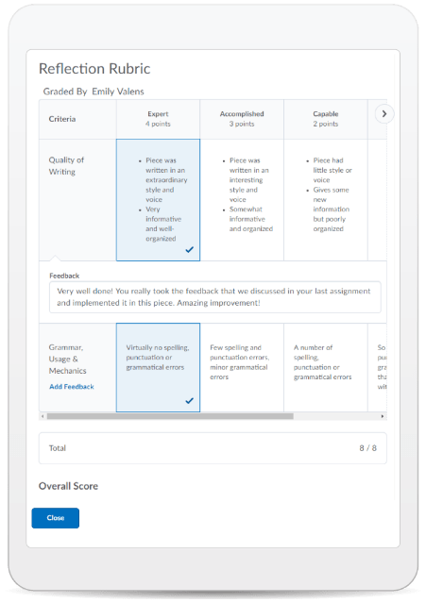
Learning Objectives:
You will be able to:
Customize your Navigation Bar (Navbar)
Customize your Homepage
Create a custom Widget
Edit your Course Banner
© 2020 D2L Corporation
Notes:
Awesome! We have accomplished all our learning objectives!

Slide 25
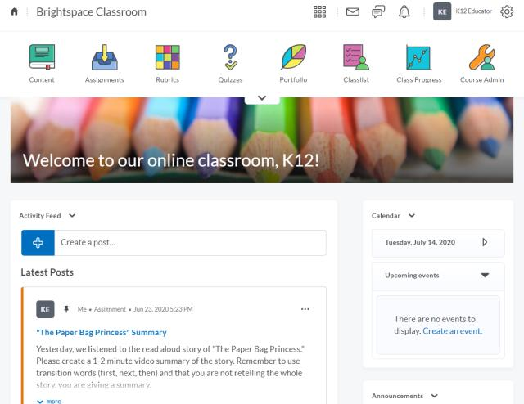
Give This a Try!
Organize your Navbar based on the tools you’ll be using with your students! Tip: Put your most used tools in the top row of the Navbar for easy access!
Personalize your Homepage: arrange your widgets for your best “classroom flow.”
Customize your Course Banner- try including a nice welcome message for your students using the {firstname} replace string.

Slide 26
Resources
Brightspace Quick Start Guide K-12
D2L Parent and Guardian Support Site
Homepage Management- Create and Manage a Course Homepage
Notes:
This page has resources specifically on personalizing your online classroom. This is also where District specific resources can be added.

Slide 27
Tutorial Videos
Communication and Collaboration | Organizing Course Materials | Documenting Student Learning | Feedback & Assessment
Announcements Activity Feed -Add Attachments and Links to Posts -Create an Assignment Post in Activity Feed -Customize Notifications for Activity Feed -For posting a message -Optimize Activity Feed Discussions | Content/Lessons Tool -Getting Started with Lessons for Instructors -Lessons: Add a New Unit and Lesson -Lessons: Add New Materials -Lessons: Reorder Units, Lessons, Folders, and Materials -Lessons: Attach a Release Condition Groups -Creating Groups -Creating Individual Student Groups -Creating Unique Learner Pathways | Brightspace Portfolio -Review and Approve Portfolio Items -Oversee and View Individual Portfolios -Brightspace Portfolio: Bring Your Own Device (for learners) -Portfolio AT HOME Assignments Discussions Quizzes -Quiz Question Converter | Rubrics -Create an Analytic Rubric -Create a Holistic Rubric Grades -Entering Grades -Associate an Activity with a Grade Item -Create a Grade Scheme Standards/Expectations -Standards: Import Standards from Course Admin Assessing or Evaluating Against Expectations Quick Eval
Notes:
There are also many quick tutorial videos available! These resources are organized pedagogically. Every underlined item is linked to a tutorial video

Slide 28
Thank you!
@Twitterhandle
#districthashtag
#D2LK12
Notes:
Thank you so much for joining us today!
If you have any questions or need any help, please consult or contact:
We’d love to see all the awesome ways you’re using Brightspace! Use our District hashtag and/or #D2LK12 so we can all learn from each other and share great ideas of how to use Brightspace to support teaching, learning and, most importantly, our students!

